Slide 1
Wyoming Orthopedics & Spine
Joint Journey Class
Notes:
I want to thank you for attending tonight.
We have with us Dr. Israelsen, Jenna (nurse navigator for the PRSC) and Tiffany Neilson (PT at Rehab Solutions)
There are refreshments for you. Please let me know if you need anything else.

Slide 2
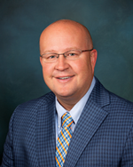
Our Surgeons Dr. Stanford Israelsen Dr. Scott Sorenson
Notes:
I am very blessed to have two of the best surgeons in the country.

Slide 3
Our goals and objectives
To provide quality joint replacement by outstanding surgeons to relieve pain and give you a more active lifestyle.
To provide safe, comfortable and compassionate care to our patients and their families.
To provide our patients with the necessary knowledge and support to produce the best recovery outcomes.
To allow patients and families a forum to ask questions.
To discuss preparation and expectations of surgery
Notes:
We are dedicated to making your life better, less pain, better function, a step to an improved life.

Slide 4
Your team:
Your team
You and your coach
Your surgeon
Your coordinator- Roxi
Your navigator/Pre anesthesia nurse
Clinic team
Anesthesia team
Surgical team
Surgery Center nursing care team
In patient nursing care team
Care management team
Rehabilitation team
Rehab
Physical and occupational therapy
Notes:
This is a journey to recovery. Everyone in the team is responsible to provide you with information, answer questions and support you in the journey.
Be your own advocate: if you don’t understand something, please ask.
Having a coach, the person who will be with you before, during and after surgery, is essential. We recommend they be with you from your first visit until you are recovered. We ask that you have someone to stay with you especially the first two weeks after surgery. If you do not, we should speak about an alternative.
These are the people who are part of your team to give you a better experience and easier recovery.

Slide 5
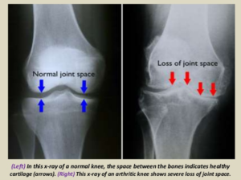
Osteoarthritis
Notes:
Osteoarthritis: wear and tear arthritis. Destroys the cartilage or the sliding and cushion surface of the ends of the bones. As the cartilage thins and pits, causes inflammation, pain and swelling. OA can cause instability of the joint, grinding and loss of ROM. This is the most common type of arthritis and the definitive treatment is a joint replacement. People with RA have an increased risk of OA due to inflammation of the joint.

Slide 6
Shoulder Osteoarthritis

Slide 7
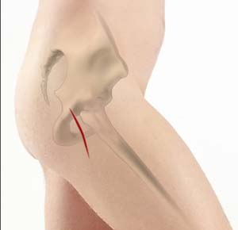
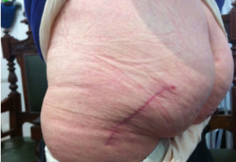
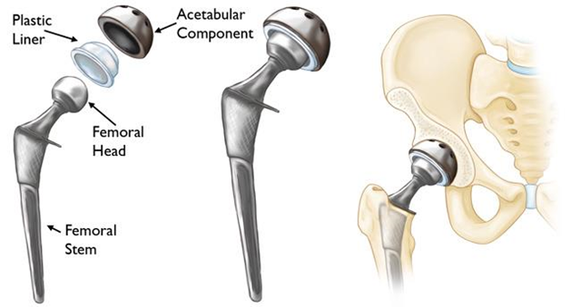
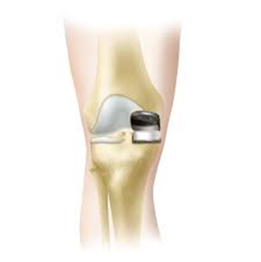
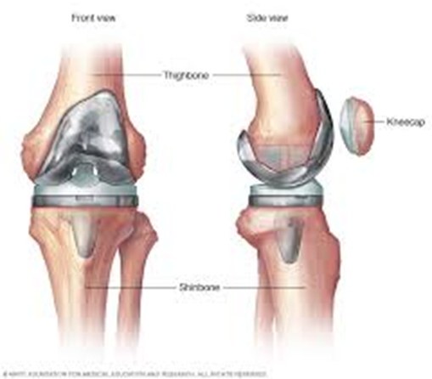
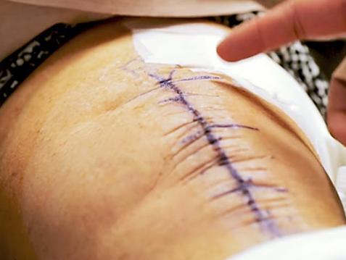
Joint Replacement
Notes:
Each replacement, the damaged cartilage and bone is removed from your joint and replaced with prosthetic components made of metal and plastic (called the prosthesis). The prosthesis mimics the shape and movement of a natural joint, in an arthritic hip, the damaged ball (the upper end of the femur) is replaced with a metal ball attached to a metal stem that is fitted into the femur, and a plastic socket is implanted into the pelvis, replacing the damaged socket. In the knee, the damaged cartilage surfaces at the ends of the femur and tibia are removed. The metal parts are cemented in. The patella is resurfaced with a plastic button. A medical-grade spacer is placed between the metal components...
Two types of knee replacement: total knee replacement and unicompartmental or partial knee replacement. The first knee replacement was done in 1968. Of course there has been tremendous improvement of the surgery since that time. There are about 800,000 knee replacement a year. Most knee replacements will last 15-20 years. The incision is closed with a surgical glue and tape (Prineo dermabond).
The hip replacement that my surgeons offer is a posterior lateral hip replacement. This is a muscle sparing procedure. The picture on the slide shows where the scar will be. This is closed again with the glue and tape.

Slide 8
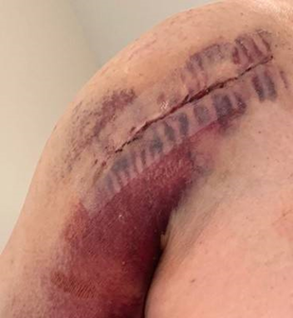
Total Shoulder Replacement
Total Shoulder Replacement
Reverse Total Shoulder Replacement
Notes:
TSA and RTSA: The shoulder replacement is similar to the hip as a stem is placed in the humerus and then for the reverse TSA a plastic cup is attached or in the TSA a metal ball is attached. The cup is then prepared and either the ball or cup is placed

Slide 9
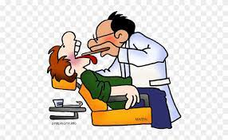
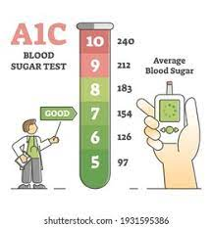
What do I need to do now?
Stop smoking
Stop illicit drugs, marijuana or CBD products, including Kratom
Start walking or exercising
Get your diabetes under control
Get your sleep apnea treated
Get dental work done 6 weeks prior to surgery
Improve your nutrition
Avoid and watch for any skin sores or rashes
CT for the shoulder replacement
Start thinking about plans for care after surgery
Rehab
Who will care for you after surgery
Notes:
We will discuss most of these points further. At any time you would like more information or need referrals please let me know. You can also talk with your primary care provider. If you do not have a family or primary care provider please let me know. You have handout at the end of the packet that will give you more specific information about smoking cessation, weight loss.

Slide 10
Why do I need to stop smoking?
Smoking causes breathing problems and increases the risk of medical complications and slows recovery.
Smoking increases risk of blood clots and infection after surgery and increases time to heal.
Studies have shown that joint replacement patients who continue to smoke before and after surgery are 10 times more likely to need a joint revision surgery than non-smokers.
Nicotine patches/gum are preferable.
Notes:
The tar and CO2 are the culprits. Nicotine itself, is not as problematic as the smoking. So patches, gum or chewing tobacco, (although we do not recommend chewing because of other risks) are acceptable for surgery. However, any tobacco use is not recommended (cigarettes, cigars, vaping or hookahs). Also no cannabis. We recommend smoking cessation for 6 weeks prior to surgery. Add. Information is available from me.

Slide 11
Is there a reason the doctor asks about my alcohol drinking?
Alcohol use that is frequent or heavy, can delay recovery and increase risk of complications such as:
Pneumonia
Infections
Delay in wound healing
Studies find that abstainers have greater health improvement after surgery than even moderate drinkers.
Be honest and tell them how many drinks you have per day or week.
Tell them if you have withdrawal symptoms when you stop drinking.
Notes:
We recommend no alcohol the last week prior to surgery and definitely the 48 hours prior to surgery. Alcohol interferes with your blood’s ability to clot and internal or external incisions bleed more resulting in more blood loss. This will slow healing. Please let us know if you have any symptoms such as nausea, sweating, shaking, anxiety or irritation if you stop drinking daily. There are more serious withdrawal symptoms that can be life threatening. We need to know so we can treat withdrawal around your surgery.
.

Slide 12
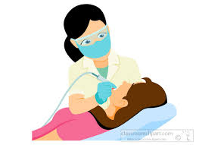
Why dental work?
If you have any dental problems, such as loose or painful teeth, please let us know as these need to be treated before surgery.
Will have to wait six weeks after the procedure and have a clearance from your dentist
If you are scheduled for urgent dental work have this done 6 weeks prior to your surgery.
After surgery, no dental work, even cleanings, for six weeks.
For the first year after your joint replacement for any dental work, even cleanings, you will need an antibiotic.
Notes:
We strongly encourage you to have a dental check up before surgery if you have not had a dental check in over two years. Also let us know if you have sores, loose teeth, or teeth that hurt when you chew. We may have to delay surgery if you have a dental abscess as this increases risk of infections.
You don’t knee to make an appointment with the dentist before surgery if you have had regular check ups.
The antibiotic for the first year, you will take this one time, one hour prior to your dental procedures. Please call the clinic at least five days prior to your dental appointment for a prescription. We will remind you at your follow up appointments about the need for the antibiotic. BE SURE to let your dentist know you have had a joint replacement in this year also.

Slide 13
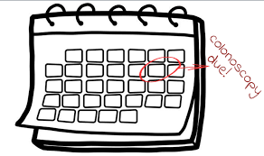
Is there any other procedure I need to postpone prior to my replacement?
Delay a routine colonoscopy until 6 weeks after surgery or delay the replacement if colonoscopy is urgent
Other surgical procedures should be done at least 6 weeks prior to the replacement
You can delay the procedure or
The replacement surgery can be delayed
If questions, talk with Dr. Israelsen, Dr. Sorenson or Roxi.
Notes:
If you have any concerns about these procedures, talk with DR. I or Dr. S or Roxi and/or your other surgeon. Replacement surgery is an ELECTIVE surgery and should not delay procedures that impair your health. To recover after replacement surgery, it is best if you are as healthy as you can be.
Remember this is a surgery to help you get on with your active life.

Slide 14
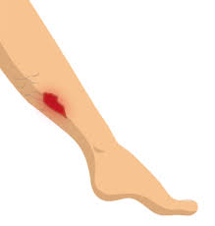
Why worry about sores or scratches?
These type of wounds can increase your risk of surgical site infection or medical complication by 2 times.
Please notify your surgeon if you have any sores, rashes, boils or skin changes as soon as you notice them.
Notes:
Wounds may cause the surgery to be rescheduled
The sooner treatment is started the more likely we can get your surgery done.

Slide 15
How do I improve my nutrition?
Eat food rich in iron, vitamin C, and calcium and Vitamin D
Get enough protein (no less than 60gm per day)
Eat more fiber
Healthy eating and proper nutrition before surgery aids the healing process.
Drink at least 8 glasses (64 oz) of water per day.
Notes:
Your Joint Journey Booklet has some ideas about food to use for higher protein and iron. Iron: lean red meat, dark green leafy vegetables. Vit C: oranges, cantaloupe, tomatoes, Calcium and Vit D: milk, cheese, yogurt, green leafy vegetables.
Drink plenty of fluids, preferably water, and prior and after surgery. Dehydration is most prevalent in older people and especially women. Dehydration can increase the risk of urinary tract infections, blood clots, post-operative blood transfusion, and longer hospital stays. We recommend trying to drink at least eight glasses (8 oz.) of water per day.
After surgery you may not have much of an appetite. Smaller meals 5-6 x daily with protein, iron and vegetables. You may add a protein shake or supplement if needed.
A nutritionist is available for consult if needed

Slide 16
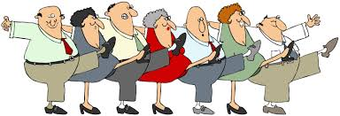
Why do I need to exercise before surgery?
Exercising up to the day of surgery, helps improve your strength, range of motion, and endurance.
Prehab (exercise before surgery) can stabilize your pain levels before surgery and gets you back on your feet faster after surgery.
A walking or water exercise program increases endurance, flexibility, and overall strength.
What type of exercise is not as important as being consistent with your exercise.
You can practice your after surgery exercises
Some are in the booklet
Notes:
Preoperative Range of Motion (flexibility) is the best predictor of your post operative outcome. Doing exercises before your replacement keeps your body and knee healthy. Patients who do prehab:
Experienced less pain before having their surgery^{[2][4]} and within 4 weeks after their surgery.^{[5]}
Had an increase in function, range of motion, ^{[3][5]} which also includes an earlier return to daily activities such as climbing stairs, using a chair and toilet.^{[5]}
Significant improvement in their thigh muscles, or quadriceps, strength.^{[3]}
Significant decrease in their length of stay in the hospital after surgery.^{[3]}

Slide 17
What will they do at therapy?
Physical Therapy (PT): work on movement and function
Occupational therapy (OT): work on activities of daily living and independence
Prehab: see your PT 2-4 weeks prior to surgery for evaluation and instruction on exercises and work with the walker
Rehab: you will see your PT/OT two to three times a week to work on your movement and function. Therapy has set protocols and assessment protocols the are approved by your surgeons.

Slide 18
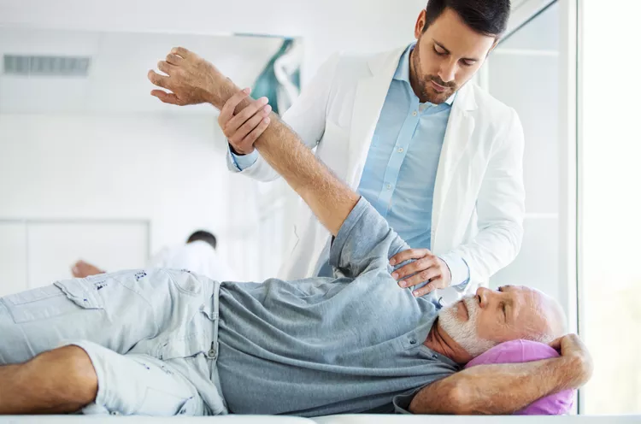
What can I do to improve my recovery?
Take pain medication about 30 minutes prior to your PT appointment.
Eat and drink prior to your PT appointment.
Ask questions and voice concerns.
Do your daily exercises: twice daily.
Ace bandage.
Ice/ice.
Knees: Work on getting the knee straight.
Balance rest with activity.

Slide 19
What can I do after shoulder replacement?
Activity After Surgery
No shoulder active range of motion.
No reaching behind the back
No moving the arm inward or outward
No lifting
No supporting body weight with hands
Place a pillow or folded towel under the elbow while lying on back to avoid the shoulder falling forward
Avoid shoulder elevation or hike
Physical/Occupation therapy will review all exercises to elbow and wrist. Do not do these exercises without instruction.

Slide 20
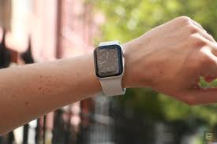
mymobility
Personalized support throughout your journey
Available for knees and hips
Timely education, checklists, and reminder notifications
Video-guided exercises
Data collection: activity levels, pain, care plan progress that you and your surgeon and care team can monitor.
Ability to text and send pictures

Slide 21
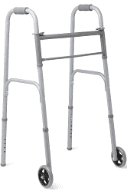
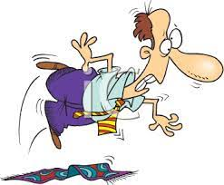
What do I do one month before surgery?
Make sure you have a coach
Should come to all appointments
Take you to and from hospital/surgery center/ PT
See your surgeon for a pre operative visit
Meeting with Roxi
Attend this class
Make a plan for care after surgery
Prepare your home
Stop vitamins and herbal supplements (two weeks)
Visit with PT for a pre-rehab visit
Have a plan for icing, such as a Game ready machine or reusable ice pack
Get your equipment: front wheeled walker, toilet riser, shower chair
Notes:
These are not in specific order and may be after one month.
The better prepared you are the less anxiety and stress just prior to surgery- so you can rest up prior to surgery.
The walker should be front wheeled only.

Slide 22
What if I get sick before surgery?
If you are experiencing a moderate to severe illness two weeks before surgery or a minor illness in the week before surgery notify your surgeon immediately.
Call if you have symptoms of:
Chest cold
Urinary tract infection
GI Infection
Fever, chills or not feeling well
Vomiting
Breathing problems, such as severe cough, wheezing.
Notes:
Any concerns call us

Slide 23
What happens at the pre-anesthesia phone visit?
A pre-anesthesia nurse will call you about 2 weeks before surgery. The goal is to review any health risks before anesthesia.
Health history of you and your family, such as problems with anesthesia, blood clots or bleeding disorders
Before surgery instructions
Additional tests may need to be ordered
May refer to a specialist if needed.
Anticipate at least one hour for the phone appointment
Have a list of your medications, including herbal, OTC and supplements
Have list of your allergies
Notes:
Jenna is here to discuss the next few slides with you.

Slide 24
What do I need to do one week before surgery?
Stop medication as directed by pre anesthesia nurse
Stop anti-inflammatory medications
Talk with care manager about post surgical arrangements if needed
Make sure you have supplies (walker, shower chair, toilet riser, etc.)
Call Roxi for any questions
If you have advanced directives, get a copy to hospital or surgery center

Slide 25
What some other tasks I need to do?
Antibiotic to nose, if ordered
May need to wash with special soap for 5 days.
Do you have your wash kit or soap?
Pack your bag
Pick up medical equipment if needed
Make final preparations of your home
Get your medications for after surgery. It is best to get the prescription the day before surgery to avoid problems.
There is no outpatient pharmacy at the hospital
Roxi will call to pharmacy Friday before or day before
If special concerns about getting prescriptions, call Roxi
Do not shave your surgery extremity 5 days prior to surgery

Slide 26
What do I do the night before surgery?
Call from OR or surgery center on what time to be there in the morning. (Monday surgeries this will be Friday)
Shower with cleanser as instructed
Drink 500 ml (2 cups or 8 oz) of Gatorade or an electrolyte drink
Take medications as directed
Stop eating solid at midnight
Notes:
Call for time will be the afternoon of the last business day prior to your surgery date

Slide 27
It is the morning of surgery, what do I do?
Take medications as directed with a small amount of clear liquid.
Drink 1 cup or 8 ounces of Gatorade or electrolyte drink 3 hours prior to surgery. For shoulders drink this 4 hours prior to surgery.
Nothing to eat or drink (NPO) for the final 2 hours prior to surgery
No chewing gum, chewing tobacco, or hard candies
Please be on time!

Slide 28
What should I bring to the hospital?
List of medications or the medications and list of allergies (do not bring medications)
You may be asked to bring specific medications with you, in the prescription bottles
Bring your Inhalers
Rubber-soled shoes or full foot slippers
Glasses with case
Hearing aide cases and chargers
Denture case
Grooming items
Comfortable clothes for the trip home (loose)
Walker
Phone charger
Please label your belongings especially your walker
CPAP machine if you use one. Please clean the machine.
Game ready or Icing machine if using one
Chap stick
Notes:
If you are having surgery at the hospital.

Slide 29
What do I bring to the surgery center?
List of medications (name, doses, timing) and allergies
Walker
Wear loose clothing and slip on shoes or full footed slippers with non slip soles
Glasses and hearing aids and cases for storage
Denture case
Game ready or icing machine if you are using one.
Inhalers
Notes:
You may bring your CPAP machine. Please clean this before

Slide 30
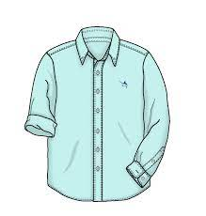
What supplies do I bring for shoulder surgery?
A large/loose-fitting button-up shirt.
Easy to pull-up undergarments/shorts/pants (i.e. athletic wear or pajamas).
Good non-slip walking shoes with a back
A cane, if used for mobility prior to surgery. (You will not be able to use a walker).
Game ready or icing machine if have one
Notes:
Thank you Jenna. If you do not have advanced directives, information is available on line. I do have some information today also.
If you are having a total shoulder, no reverse, and surgery at PRSC you should get a shoulder immobilizer fitted Let me know if you need an order for an immobilizer.
For a reverse shoulder a simple sling will be put on after surgery. This will be supplied.

Slide 31
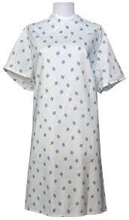
What happens at the OR?
Check in to hospital OR or surgery center
You will get a gown, bonnet, head to toe assessment and IV
Surgical site will be prepared
Anesthesia will visit with you about your anesthesia
General
Spinal with sedation
Nerve block: these are usually done in the
pre operative area.
Notes:
CCH: OR check in by the coffee shop.

Slide 32
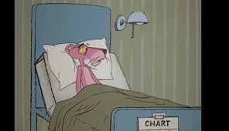
What do they do in the operating room?
You are taken to the OR room
The OR is cold, so warm blankets are given
You will be asked to move over to the operating table
Monitors will be attached, anesthesia will begin
Tourniquet for knee replacement
Notes:
Family will be asked to go to the waiting room when to you are moved to OR.
For knees. The tourniquet will causes some bruising and tenderness after surgery

Slide 33
Where do my family/friends go?
Your coach/family member may stay with you in the pre operative area prior to you moving to the operating room.
Hospital: Family members to wait in the waiting room by the coffee shop
Surgery Center: Family members will wait in the waiting room
Surgeon will speak with your family after the surgery is completed. PLEASE answer the phone.
We ask that family leave contact information prior to leaving the facility.
Notes:
Surgeons have little time between cases to re call. So ANSWER the phone. This number may come up as unknown. But please answer.

Slide 34
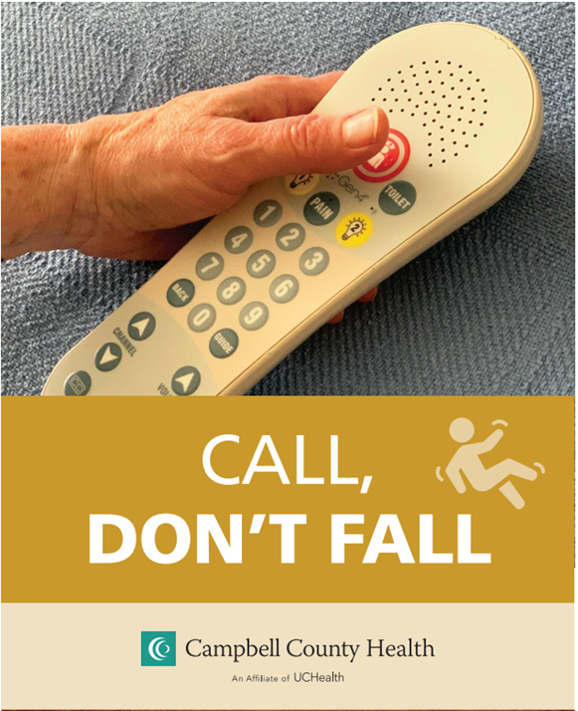
I am having surgery at the hospital, what happens when surgery is completed?
You will go to recovery for about 1-2 hours
No visitors
Then you will go up to your hospital room on the 2nd Floor
Family can visit
You must call for assistance
Every time you get out of bed
Please use your walker for ambulation at all times
You are weight bearing as tolerated on your surgical leg
The nurses or therapists will use a gait belt for safety
You are expected to walk after surgery
Notes:
You will be up as soon as possible. You will be up to use bathroom, for personal care.
Nursing and PT will use a gait belt for safety.

Slide 35
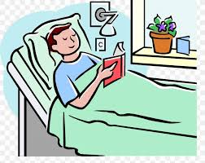
What will happen during my hospital stay?
Diet: will start with clear liquids and ice chips and then start your regular diet when ready.
Pain management
Physical therapy and occupational therapy will see you after surgery on that day of surgery
Keep active
Prevent pneumonia
Prevent blood clots
Helps you to feel better and decreases stiffness and pain
Notes:
For shoulders you may be given an incentive spirometer. Please us this.

Slide 36
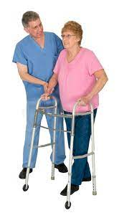
My surgery is at the surgery center, how do I prepare to go home?
Once you are awake and you have sensation and strength, PT or nurse will help you with walking with the walker.
You must call for assistance every time you get up
Your family will be able to be with you in recovery
Once you are safe, you will be discharged to home.
Usually about 4 hours

Slide 37
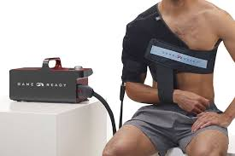
I had surgery at the surgery center. What do I do the next day?
Stay with clear liquids until you are ready to start your regular diet.
Deep breathe and cough to expand and clear your lungs. Pain management. See the pain management booklet.
Be careful: Use walker at all times
Ask for help!!
Start PT within 48 hours after surgery
Keep active
Ice, ice, ice
Rest
Notes:
For shoulders you may be given an incentive spirometer. Please us this.

Slide 38
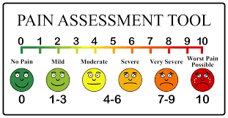
What about pain?
Pain management is an important part of your care and recovery. Keeping your pain under control will help you participate in healing activities, deep breathing and PT/OT so you heal faster.
Pain is normal even with medications. Zero pain is not safely possible.
Our goal for pain management is to keep your pain at or below your comfort-function goal.
Comfort-function goal is the amount of pain you can comfortably tolerate and move in bed, get up for PT, deep breathe/cough and do your exercises.
Notes:
The block will start to wear off slowly. So be sure you have started pain medication before this time.
For more specific information about pain medications, refer to the Pain Medication: Your questions answered.
If you have questions or problems, call Roxi

Slide 39
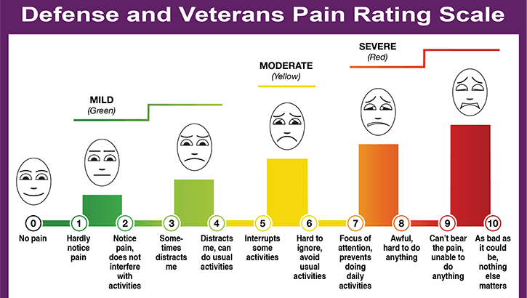
Functional Pain Scale
Our goal for pain management is to keep your pain at or below your comfort-function goal.
Comfort-function goal is the amount of pain you can comfortably tolerate and move in bed, get up for PT, deep breathe/cough and do your exercises

Slide 40
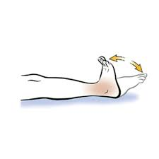
What is the plan to help me with my pain?
Peripheral nerve block
Done at time of surgery
Usually wears off in 24 hours
Oral medications
Non pharmacological
Ice, slow deep breathing, music, TV, family visits
Movement: to help prevent stiffness that can increase the pain
Use pain medication or interventions when pain increases
Ice and elevate the surgical site
If using a game ready or icing machine, program for 30 minutes
Icing, 30 minutes off, medium compression.
Notes:
The block will start to wear off slowly. So be sure you have started pain medication before this time.

Slide 41
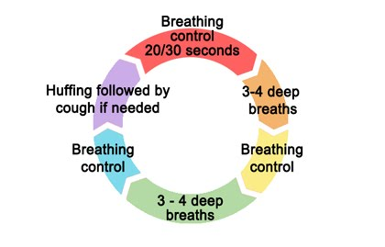
aCough: for pneumonia prevention
Get active
Improves lung function, pain control, circulation, muscle strength, gut function, mental health
Cough: take 3 deep breaths and then cough as you exhale
Oral health: toothpaste and mouthwash 2x daily
Understand your surgery
Get out of bed
Head of bed elevated (45 degrees)

Slide 42
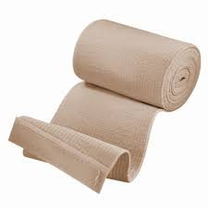
How do I prevent blood clots?
Aspirin or anticoagulant (blood thinner) to take daily as ordered by the surgeon
Ace wrap (Knees)
Wear day and night for the first three days after surgery
Use ace from foot to thigh if have swelling
Compression hose may be used on the non surgical leg.
You may use on both legs for swelling
Compression devices (at the hospital)
Foot pumps and exercises when resting
Move: walk or use your post operative exercises
Notes:
We do not recommend the thigh hi because of rolling down. Knee Hi are okay for the opposite leg (knees) and both legs for hips and shoulder
Keep the wrap on the leg up to two weeks if possible.

Slide 43
Is there a risk of falling after surgery?
Causes of falls after surgery
Fluid and/or electrolyte imbalance
Muscle weakness
Using stairs that are too steep or narrow or without handrails
Lack of light
Excessive clutter, stray electrical cords, oxygen tubing, throw rugs or pets
Unstable furniture
Uneven surfaces, ice, water
Incidence of falls in the first year after a hip replacement is 25-32%
50% of falls occur in the bathroom, be sure to have someone help you in the bathroom. Watch for water on the floor.
Risk of fracture with falling
Notes:
Studies show an increased risk of falling within the first months after surgery
Never ambulate without assistive device (walker, cane). PT will advise when you can change devices or discontinue.
Wear non slip shoes with full backs when up.
Remove trip hazards
If you need glasses or contacts, wear them
Work with PT on your balance
Tai Chi has been shown to improve balance in older adults
Keep well nourished and hydrated to prevent weakness
Remember that pain medications can alter your perceptions

Slide 44
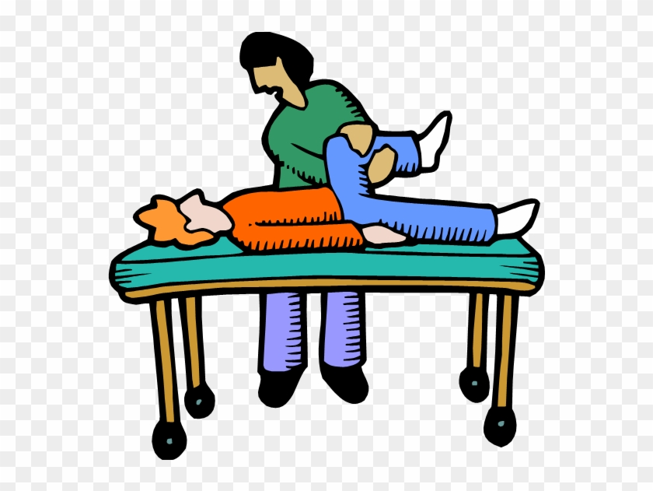
What do I need to do at home?
PT
2 week appointment at WYOS
Medication
Pain medication
Anti inflammatory
Aspirin or anticoagulant
Stool softener
Call for refills at least 24 hours (before Friday) before needing them.
Be active. Walk and do your after surgery exercises. Go to physical therapy.
Notes:
Therapy will start usually within 48 hours of surgery. However, between PT sessions you will need to do exercises, as Tiffany told you about and what PT instructs.
Be sure to keep active this makes your recovery faster and smoother, helps prevent blood clots, lung issues, constipation and stiffness. Plus you feel better.

Slide 45
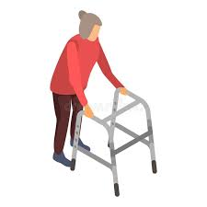
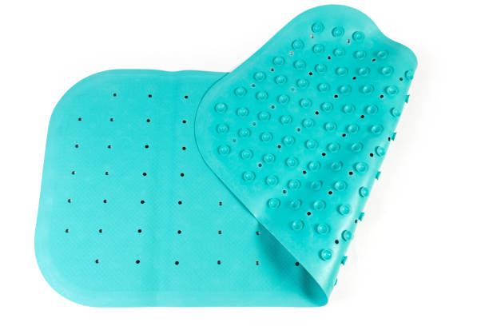
How do I prevent falls?
Wear supportive and non slip shoes at all times.
Use your walker at all times.
Go to PT and do your home exercises.
Watch for water in bathroom and kitchen.
ASK for help, especially at night.
Don’t stand to get dressed.
Non slip mat or pad in the shower, keep shower floor clean.

Slide 46
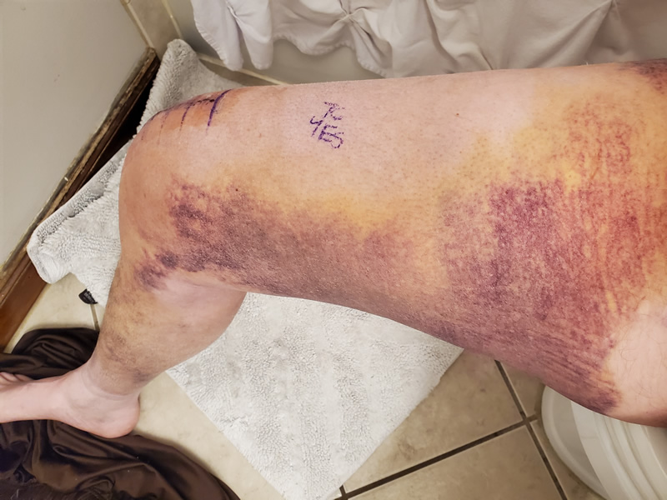
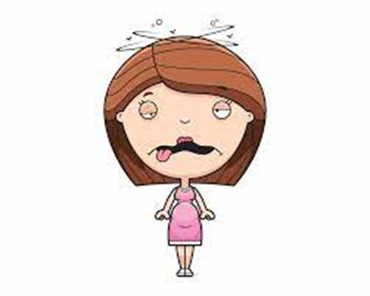
What is normal after surgery?
Pain
Swelling
Stiffness
Bleeding or dried blood on the bandage
Bruising
Upper thigh with knee replacement
Bruising moves with gravity
Constipation
Nausea
Notes:
Small amount of blood, either fresh or dried on the bandage and wound
Nausea and vomiting are not diseases, but they are symptoms:
Medication, pain, emotional distress, over eating, slow stomach emptying, constipation
If you have a tendency to have nausea or vomiting, please let me know- can get you mediation to help
Things to do for nausea: Let us know, take the medication prescribed, eat small meals and before taking medication (few saltines or toast. Avoid sugary snacks or foods, avoid drinking too much liquid with meals and drink slowly between meals to prevent triggering nausea, Small sips of lemon water or such on ice chips.
Let stomach settle after meals, avoid activity right after eating. Lie down in dark room with cold cloth on your forehead. Ginger or peppermint can be helpful. chamomile tea

Slide 47
It is normal to have:
Good days and bad days
Slight redness and/or heat around the wound
Fatigue
Frustration
This is a journey.
Rushing is not the answer. The pain is temporary. The end goal is to have relief that lasts a life time
There is a light at the end of the tunnel
Every replacement and every person recovers differently

Slide 48
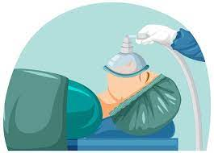
What are some effects from anesthesia?
General anesthesia
Common to have some “brain fogginess”, disorientation, problems remembering things. Usually goes away in a week or two.
Dry mouth, sore throat, mild hoarseness
Dizziness, shivering, nausea and muscle aches
Spinal anesthesia
Temporary loss of sensation or a “pins and needles” sensation
Muscle weakness
Headache
Urinary retention (unable to urinate)

Slide 49
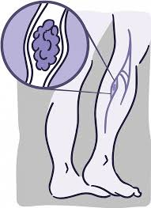
What are some rare complications?
Wound issues
Dehiscence
Stitch abscess
Blood clot
Severe bleeding
Infection
Extreme stiffness
Nerve injury
Prosthetic loosing or dislocation
Notes:
Dehiscence is when the wound opens. This we need to see you as soon as possible to prevent infection or other problems.
You will have some calf muscle tenderness, but if you have increasing swelling, a very tender, maybe red and hot calf or thigh, have pain when pulling your toes up. Please call as this may be a sign of a DVT
If you have chest pain such as sharp pain in the chest, sweating, difficulty breathing, you need to call 911 or go immediately up to the ER>

Slide 50
How do I prevent an infection?
Hand washing for you, family and care givers.
Do not pick or put your hands on the wound
No tub baths, hot tubs, pools. Do not submerge yourself in water
Be careful around pets (keep them off the surgical side)
Keep the wound clean. Keep dry for showers until instructed that you can shower without covering.
Call WYOS or Roxi if you notice redness, drainage, or have fever or chills.
Notes:
Frequent and good handwashing is very important.
Do let your pets lie on your operated side. Wash your hands after handling your pets.
In 72 hours you can take down the ace bandage wrap and the outer dressing. DO NOT remove the big tape over the incision. Shower, no bathing. Pat dry to not rub or scrub the wound. Do not put any ointments or creams over the wound.

Slide 51
When and where do I call if I have questions?
Your thigh or calf becomes more painful, red and swollen
Pain when you flex your ankle
Your incision has increased drainage, getting more red or is opening up
You develop a fever over 101° F or persistent low grade fevers
After hours, call the ER and they will have your surgeon call you back
If you have chest pain, shortness of breath or difficulty breathing, call 911 or go immediately to the ER
Call WYOS at 307-686-1413 or Roxi at 307-688-8674
Notes:
For most questions, call the office during office hours or Roxi.

Slide 52
Frustrated? Unhappy? Fearful?
Please remain realistic during your recovery
Do not set yourself up for disappointment as this is a long process
The pain can be intense initially
Make sure you have a coach, such as a family member or friend, who will be with you throughout your surgical experience
Recovery is a day to day process. Some days are better than others.
Recovery takes dedication
Slowly you will find daily activities are getting easier
Everyone heals and recovers differently
It is normal to feel anxious, depressed, frustrated, angry and fearful throughout the healing process. Talk about it and express your frustration.
You will have to rely on others for a time, which can be stressful for you and for the care giver. Find times for each of you to take a break.
Please call us if you need to talk about the recovery process
Notes:
Recovery takes time from 3 to 6 months
It can take up to 12 months for the joint to be “yours”
There will be pain, intense pain initially but this will get better over the first few weeks.
There will be swelling and bruising but this improve as healing progresses
We recommend this person be with you from your first visit with the surgeon until you are recovered.
Therapy appointments
Daily exercise and stretching
It is hard work!
NO a bed of roses.
Remember where you have come from-

Slide 53
Contact names and phone numbers
Roxi Peters: 307-688-8674 or WYOS 307-686-1413
Becki Peterson: 307-688-8661
Pre anesthesia (hospital): 688-1825
Surgery center: 696-5643
Care Management: 699-3030
Notes:
Roxi is the best person to call. If you need to talk with me right away, call WYOS number and the office staff will find me or ask to talk with a nurse.
If this is urgent, please let them know that you need to speak with me or the nurse. If it is a refill or not urgent, a message can be taken. I do have a voice mail also.

Slide 54
Outside sources
American Association of Hip and Knee Surgeons: AAHKS
https://hipknee.aahks.org/
Up to date and extensive articles about hip and knee replacement, preparing for surgery, your health, exercises, after surgery, non surgery options, podcasts, material in Spanish, and testimonials
American Academy of Orthopaedic Surgeons: AAOS
https://orthoinfo.org/
Zimmer Biomet
https://www.zimmerbiomet.com/en/patients-caregivers.html
Notes:
These sources have good and accurate information. DO NOT rely on other peoples opinion, random internet searches or “Fake information”. Use the experts and us.

